Slide 1
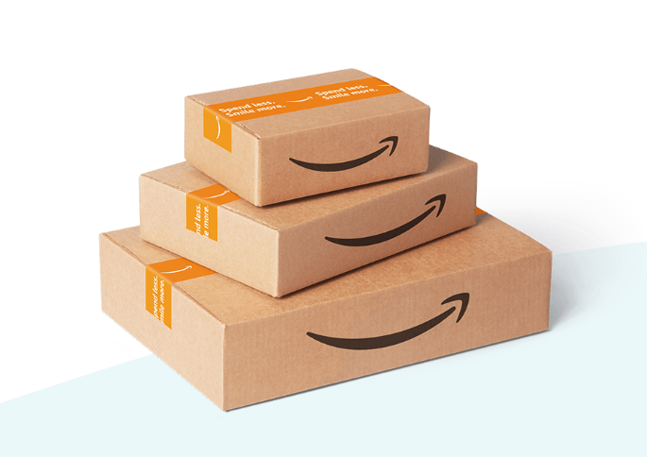
Capston Project - Amazon Sales Data
Name- Urmila Divekar
ID- S7116

Slide 2
Contents
Project Overview
Project Scope
Business Problem
Business Objectives
Data Collection and Understanding
Product Analysis
Sales Analysis
Customer Analysis
Recommendation

Slide 3

Project Overview
This project is to gain insights into the
sales data of Amazon to understand
the different factors that affect
sales of the different branches by
using MYSQL workbench IDE tools.

Slide 4

Project’s Scope
This projects scope includes developing
a insights from sales data given by
amazon by using MYSQL workbench.
This solution also help to improve sales
business.

Slide 5

Business Problem
Having a vast array of products and
sophisticated recommendation algorithms,
Amazon faces the challenge of
continuously improving the relevance and
effectiveness of its product
recommendations to enhance
customer satisfaction and drive sales.

Slide 6

Business Objectives
Utilize Amazon sales data analysis to identify
opportunities for increasing revenue and
market share by leveraging data-driven
insights to optimize sales strategies, improve
customer experience, and drive business
growth.

Slide 7

Data Collection and Understanding
Data collection:
We use a primary data source for collection-Excel and MYSQL
Data Dictionary:
Here is the list of column names: ‘Invoice-ID’, ‘Branch’, ‘City’,
‘Customer Type’, ‘Gender’, ‘Product Line’, ‘Unit Price’, ‘Quantity’,
‘Tax’, ‘Total’, ‘Date’, ‘Time’, ‘Payment’,‘ Cogs’,
‘Gross Margin Percentage’, ‘Gross Income’, ‘Rating’,
‘Time of day’, ‘Day name’, ‘month name’.
Data Dimension:
1000 Rows X 17 Columns + (3 columns added)

Slide 8
Data Description
Column | Description
Invoice Id | Invoice of the sales made
Branch | Branch at which sales were made
City | The location of the branch
Customer Type | The type of the customer
Gender | Gender of the customer making purchase
Product Line | Product line of the product sold
Unit Price | The price of each product
Quantity | The amount of the product sold
VAT | The amount of tax on the purchase
Total | The total cost of the purchase
Date | The date on which the purchase was made
Time | The time at which the purchase was made
Payment Method | The total amount paid
Cogs | Cost Of Goods sold
Gross Margin Percentage | Gross margin percentage
Gross Income | Gross Income
Rating | Rating

Slide 9

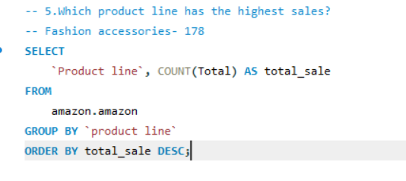
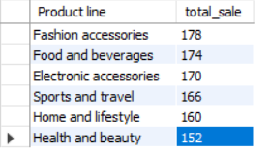
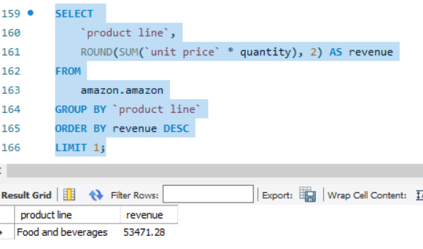
Product Analysis
In this data product line are 6, out of
which fashion and accessories has a
highest sale and health and beauty
has a lowest sale.
Food and Beverages has highest
revenue (Top-performing product line)

Slide 10
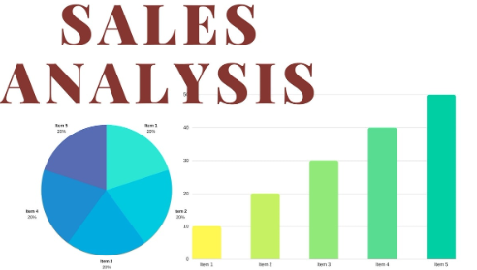
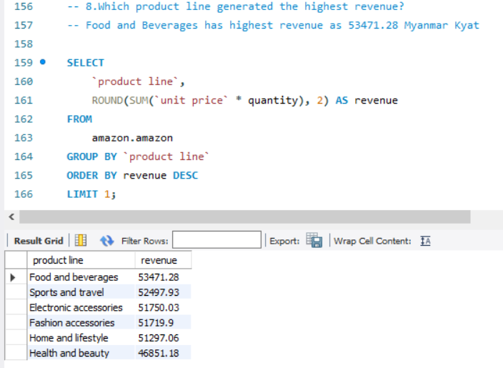
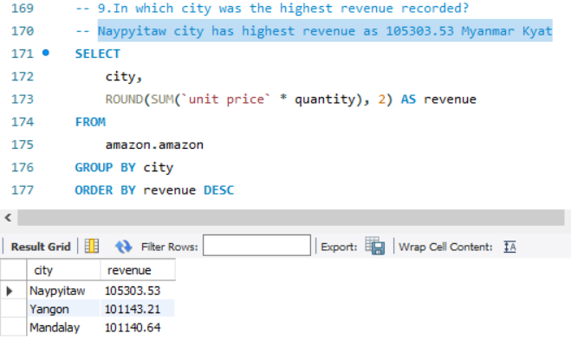
Sales Analysis
In terms of product line for food and beverages has
a highest revenue i.e. Myanmar kyat 53471.28 and
health and beauty has lowest revenue as 46851.18
Myanmar kyat.
Naypyitaw city has highest revenue as 105303.53
Myanmar Kyat and Mandalay city has lowest revenue
as 101140.64 Myanmar kyat.
In terms of time of day afternoon timing is
having high count of sale occurrence.

Slide 11
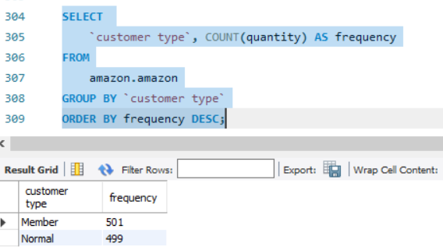
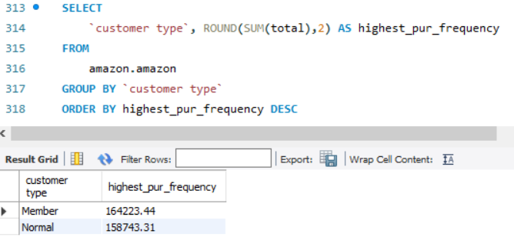
Customer Analysis
Purchase Frequency:
member customer type has highest purchase
frequency and contributing highest revenue.
Member customer type occurred most
frequently.
Predominant gender among customers in
dataset is female.
In afternoon time customer provides most ratings.

Slide 12
Recommendations
Analyze the factors contributing to the success of the food and beverages line and apply similar strategies to the other product line.
By proving special offers on morning and evening time can improve business growth.
Invest in product quality improvement.

Slide 13


